Slide 1

Credit Loan Prediction
Inggriani Priscilia

Slide 2

Introduction
Prediction about customers who want to apply loan rejected or accepted based on previously data from 2007 until 2014.

Slide 3

Table of contents
01
02
03
04
Exploratory Data Analysis
Data Preprocessing
Modelling
Evaluation

Slide 4
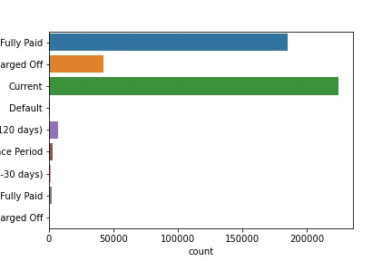
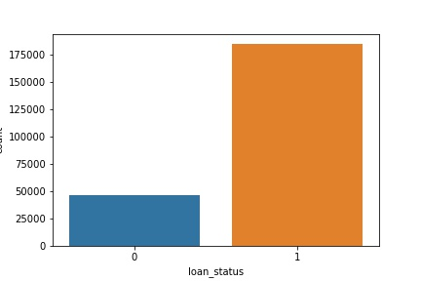
01
0: Rejected 1: Approved

Slide 5
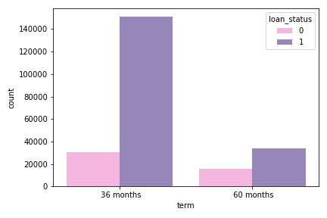
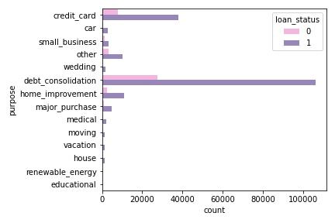
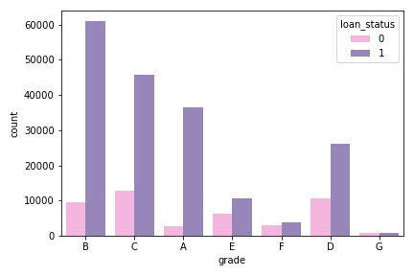
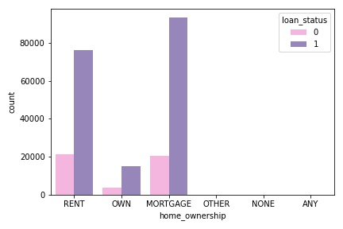

Slide 6
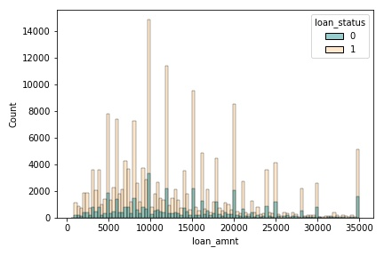
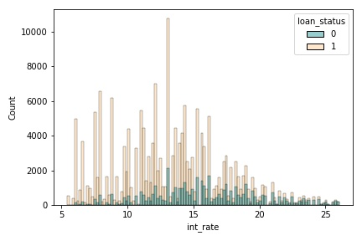

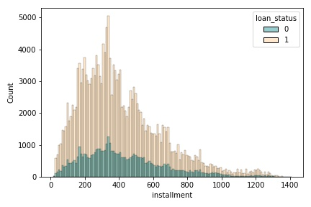

Slide 7

02
Drop unique column, only one unique, free text, so many nonunique.

Slide 8

To do List
Term column: remove months
Emp_length column : remove years and change <1 year to 0
Issue_date, earliest_cr_line_months, las_credit_pull_d, next_pymnt_d, and next_pymnt_d column : to months
Missing value to fillna median or means or frequent.
No duplicate data

Slide 9

Future Encoding & Scalling
Label Encoding
One Hot Encoding
MinMaxScaller
Grade, verification status, initial list status, pymnt plan
Home ownership and purpose
Data numerical

Slide 10

Split Data
7
3
3
Train
Test
Target : Loan Status

Slide 11

03
Model :
Logistic Regression
Decision Tree
XGBoost

Slide 12
 | Logistic Regression | Decision Tree | XGBoost
Accuracy | 0.99 | 0.99 | 1.00
Precision | 0.98 | 1.00 | 1.00
Recall | 1.00 | 1.00 | 1.00
F1-Score | 0.99 | 1.00 | 1.00
AUC | 0.96 | 0.98 | 0.99

Slide 13
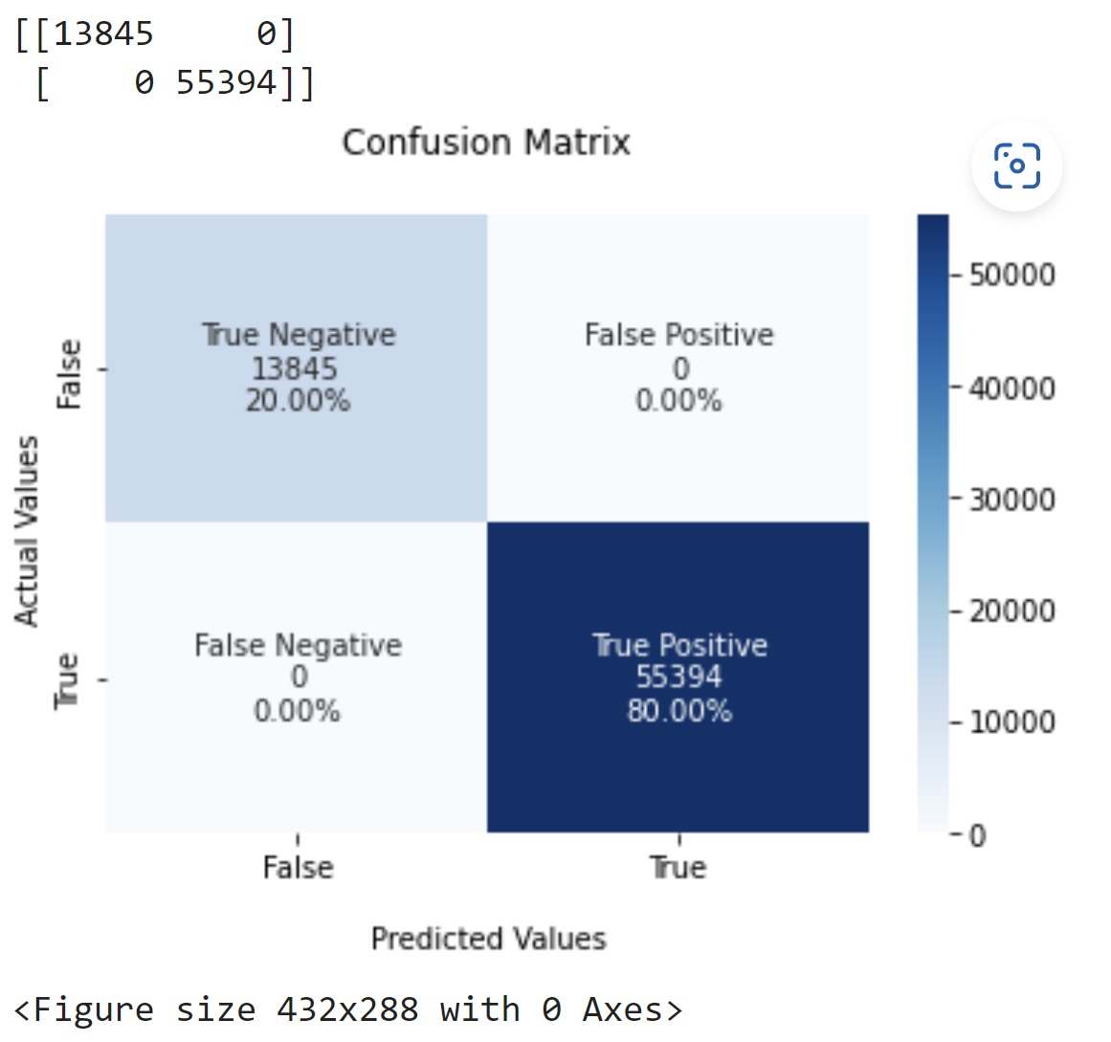
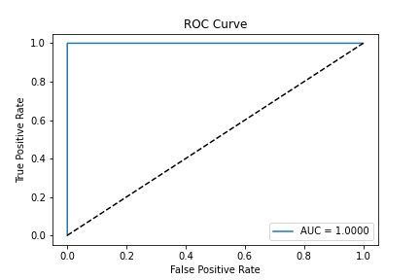
Best Model
XGBoost

Slide 14

Future Importance
Recoveries
Funded_amnt
Total_rec_prncp
Last_pymnt_amnt
Loan_amnt
Last_credit_pull_id_months
Terms
Month_issue_d
Inq_last_6mnths
Out_pncp

Slide 15

THANKS
For more information, you can contact me:
Email : prisciliainggrani@gmail.com
LinkedIn : https://www.linkedin.com/in/inggriani-priscilia-69779b179/
Github : https://github.com/inggridpris/Credit-Loan-Prediction

